Slide 1
One of the Nation’s Leading Academic Health Systems
$2.6 BILLION
TOTAL REVENUE
$240.3 MILLION
IN COMMUNITY BENEFIT
(Through end of fiscal year 2022)
150+
LOCATIONS ACROSS STATE OF FLORIDA
•
SERVING 6.7 MILLION PATIENTS ACROSS 15 COUNTIES
700+
60+
15,000+
TOTAL TEAM MEMBERS & MEDICAL STAFF PROVIDERS
RESIDENTS & FELLOWS
TRAINING PROGRAMS
1,588
LICENSED BEDS
(Incl. 6 Hospitals)
LEVEL 1 TRAUMA CENTER
47,000+
SURGERIES
56,404
130,000+
652,269
7,200+
DELIVERIES
740+
TRANSPLANTS
INPATIENT DISCHARGES
TOTAL VISITS
(Emergency & Trauma Center)
OUTPATIENT VISITS
All data through end of fiscal year 2023. Community benefit through fiscal year 2022.

Slide 2
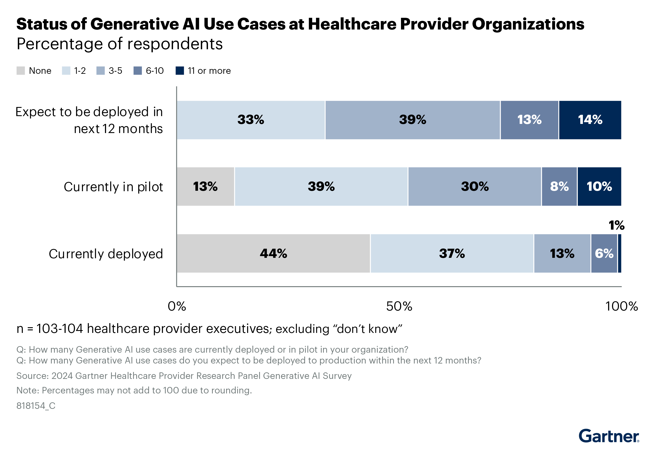
81% of Healthcare Orgs: Fewer than 2 GenAI Apps
Tampa General is in top 7%: 7+ GenAI Apps
Notes:
Case Mgmt
PSI
MRISync
Ambient
Inbasket
IP
Sepsis

Slide 3
Human AI Collaboration
AI as a clinical copilot
Enhancing not replacing human touch
Training clinicians to work alongside AI

Slide 4
AI Governance at Tampa General
Governance and Expert Vetting Remain at the Forefront
TGH Experts Carefully Review the Application of AI
Clinical/Business Utility/Validity
Comprehensive Security Review
Safety +
Ethics Review
Risk +
Compliance
Learner Impact
AI Governance Membership
Clinical Leadership | Safety / Quality | Risk
Regulatory / Compliance | Cybersecurity | Ethics
Operations / Service Lines | Legal | Informatics / BI / IT

Slide 5
Thank you
Questions or comments: jweber@tgh.org

