Slide 1
Recommended Practices for AI in MS&T Thoughts for Consideration
Robert A. Sottilare, Ph.D.
Vice President for Training & Simulation Solutions
bob.sottilare@soartech.com
Presentation for the Congressional M&S Leadership Summit 2025
Jacksonville, Florida – 18 February 2025

Slide 2
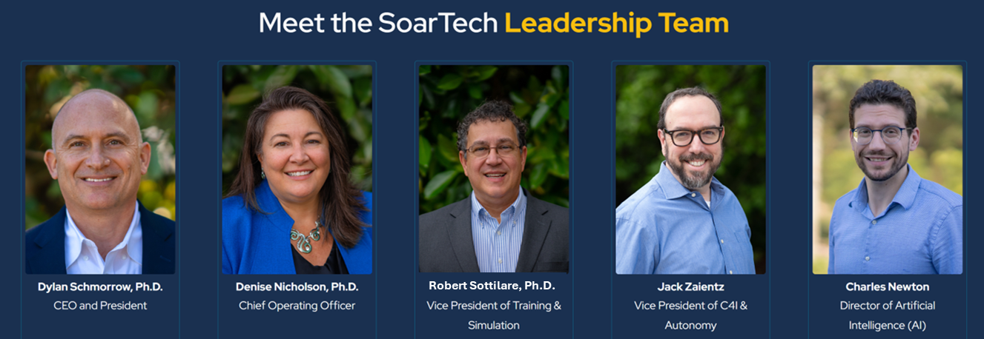
SoarTech…
A spin-off of the Artificial Intelligence (AI) Laboratory at the University of Michigan rooted in cognitive science and innovative multi-disciplinary research.
Nearly three decades of developing AI approaches to the military’s toughest training, simulation, C4I and autonomy challenges
At SoarTech, we believe AI is most effective as a force-multiplier for humans. That is why we pride ourselves in combining knowledge leaders in research and engineering to create unique solutions that save time, money, and lives.

Slide 3
A little bit about Bob…
VP for Training & Simulation Solutions at SoarTech (previously Director of Learning Sciences)
Founding Director & CTO, Army SFC Paul Ray Smith Simulation & Training Technology Center
Former Chair of the Army Materiel Command’s Distributed Simulation Working Group
Chair, Live Instrumentation Working Group in support of IEEE 1278 DIS Standards
Father of GIFT, an open-source adaptive instructional system (AIS) software architecture
Founding Chairman of the Board & Executive Director, IEEE AIS Consortium
Founding Chair, AIS Conference & IEEE Project 2247 AIS Working Group
Over 40 years in the Training & Learning Sciences field
Recipient of Lifetime Awards for Excellence in Modeling & Simulation (Army & NTSA)
Patent, High res. head mounted projection display for embedded training (US 7,525,735)
Doctorate in Modeling & Simulation (M&S) from UCF with a focus in Intelligent Systems
Founding Editor of the Design Recommendations for Intelligent Tutoring Systems (ITS)
UCF Graduate Faculty Scholar & former Adjunct Professor (ITS Theory & Design)
Past Associate Editor for IEEE Transactions on Learning Technologies
Author of over 300 technical publications with 3400 citations (i-index = 63, h-index = 29)

Slide 4
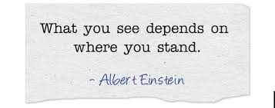
Indicators of legislative & policy needs
Legislative & policy perspective (regulation, compliance, oversight, security)
Stakeholder perspective (affordability, transparency, trust, sustainability)
User perspective (usability, reliability, bias, performance, safety)
Business perspective (ROI, growth, profit, innovation, scalability, market share)
Developer perspective (agility, modularity, robustness, interoperability)
Researcher perspective (novelty, rigor, discovery, insight)

Slide 5
Recommended Policy for AI in MS&T
Stakeholder Collaboration
Balanced Regulatory Frameworks
Agile Policy Mechanisms
Robust Data Governance & Interoperability Standards
Incentivize Research and Public-Private Partnerships
Notes:
Stakeholder Collaboration:
Engage a broad spectrum of stakeholders—including industry experts, academic researchers, and government agencies—to co-create guidelines.
This inclusive approach helps ensure that policies are well-informed, practical, and reflective of the broad needs of the community.
Balanced Regulatory Frameworks:
A balanced regulatory framework refers to a policy structure that harmonizes innovation with robust oversight.
Establish clear, enforceable guidelines to address risks, ethics, and accountability while remaining sufficiently flexible to adapt to technological advances.
Provide for open-source datasets to support AI research, development and capability validation.
This flexible framework would involve stakeholder engagement, transparent standards, and iterative updates, ensuring that regulatory measures safeguard public and operational interests without stifling creativity or progress.
Agile Policy Mechanisms… the AI marketplace will continue to evolve rapidly
Implement regulatory frameworks that are iterative and adaptable, allowing for timely updates in response to rapid technological changes.
This approach minimizes the risk of policies becoming outdated as AI capabilities evolve.
Robust Data Governance and Interoperability Standards
Establish clear data management and interoperability standards that promote transparency, data integrity, and accountability.
By doing so, policies can support innovation in AI-driven MS&T while enhancing reuse and driving down integration costs.
Incentivize Research and Public-Private Partnerships
Encourage innovation through targeted funding, tax incentives, and support for public-private partnerships.
Such initiatives can stimulate research and development while ensuring that advancements in AI align with public interest and security objectives.

